Slide 1

Senior Design II Progress
Chef Jarvis
2/12/2018
ECEN 478: Senior Design Project 1
Notes:
Outline: Introduction, Team, Diagrams, Design with Positioning, Challenges, Design with Positioning, Mechanical Design

Slide 2
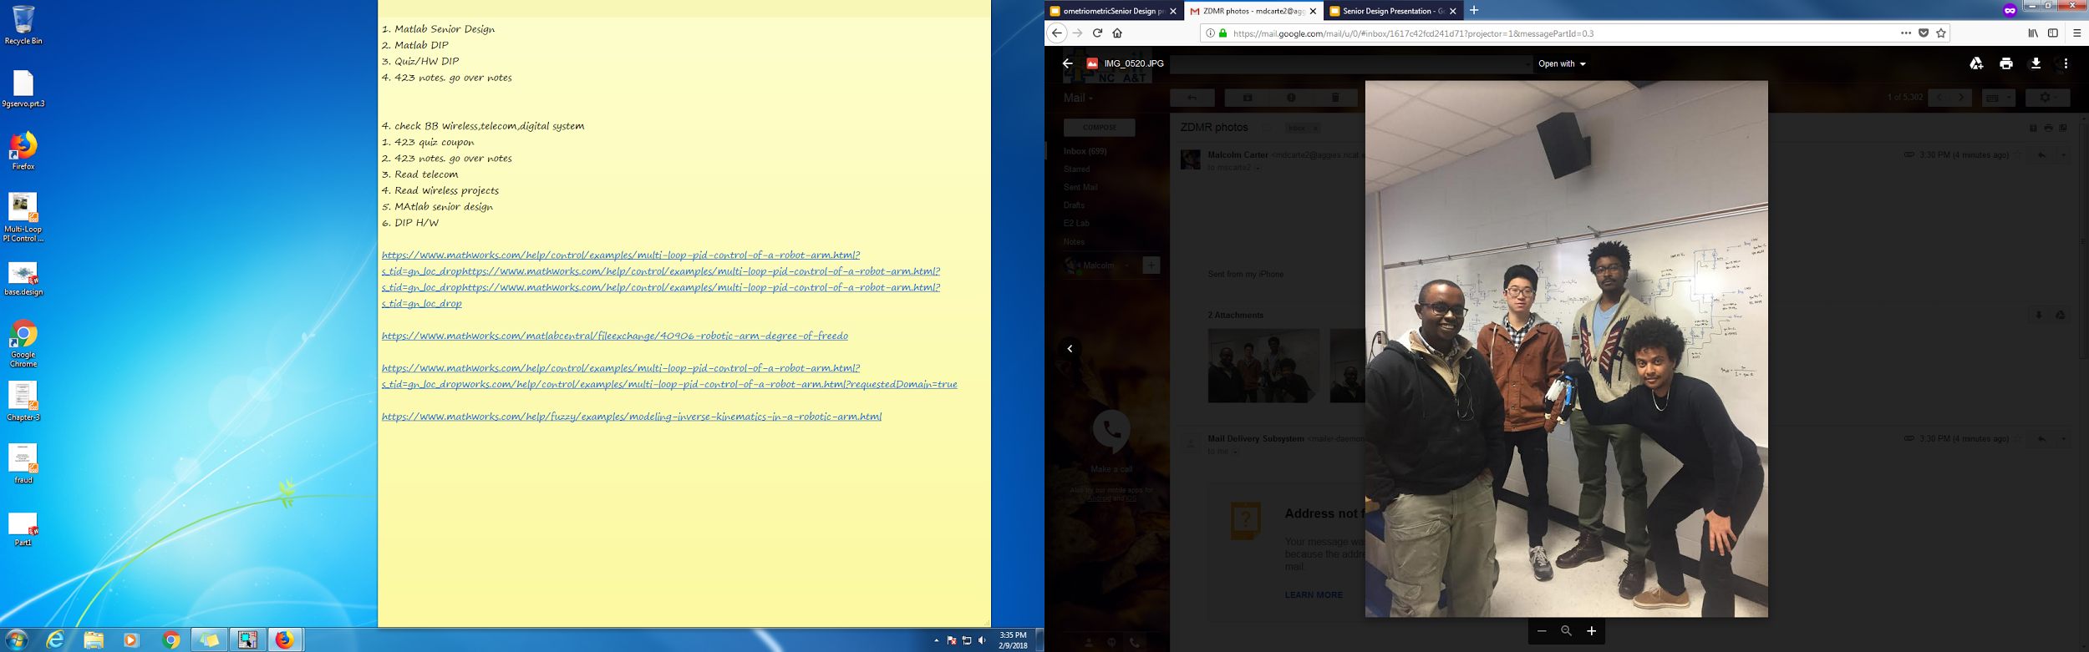
ZDMR, Inc.
Hardware Engineer
Software Engineer
Leader
Design Engineer

Slide 3

CHEF JARVIS: Autonomous Robotic Assistant
Shall remove all dirty dishes to a predefined location
Shall operate without breaking or spilling things
Shall regularly check all systems for proper operation
Notes:
Malcolm
Narrative: We’ve all been in this position (or your mother has). You’ve just spent HOURS slicing, dicing, sauteeting, turning, burning and boiling a delicious meal! You sit down at the table, and gobble up that carefully prepared food in about ten minutes flat. You sit back, utterly satisfied with droopy eyelids and then BAM! Those pupils of yours see the horrible mess that is your kitchen. But you’re feeling very sleepy, or terribly lazy since you’re engineers. The last thing you want to do is spend the next hour cleaning up your kitchen! Why can’t someone just do it for you? With Chef Jarvis, someone can *BIG TOOTHY SMILE, CONVINCING NODDING OF THE HEAD, ENTHUSIASTIC THUMBS UP)

Slide 4
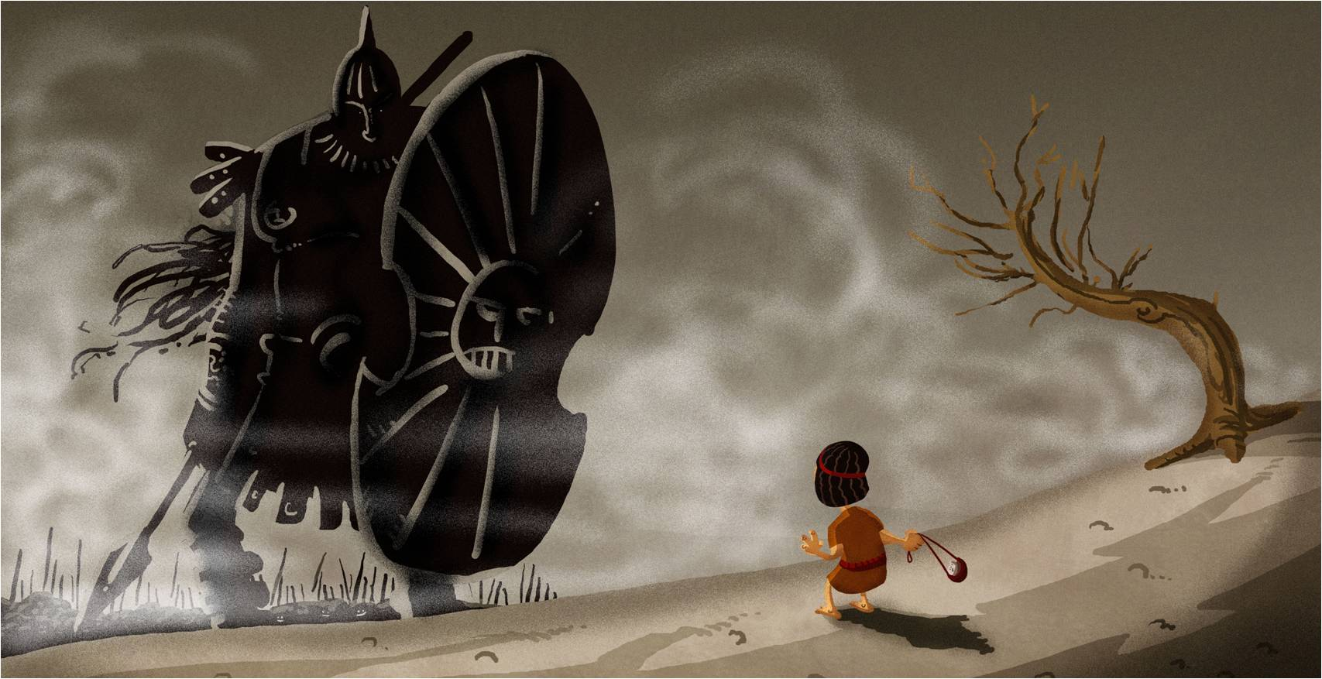
Challenges
Mechanical design and assembly
Hand design and gripping
System Design
DESIGN PROJECT
SQUAD
Notes:
Yi Si
Torque Calculations
Statics and Mechanics
Positioning: Inverse Kinematics
Logic of the states
Mechanical Design and Assembly
How each part will be communicating with each other

Slide 5
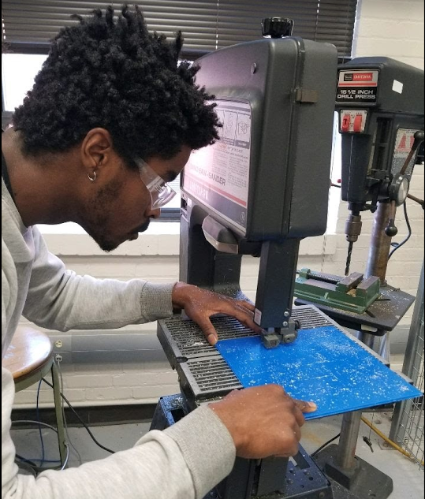
Mechanical Design
Building from Scratch!
Motors
Base
Joints
Notes:
Malcolm
Motor Torque- motors rated 20 kg-cm at 7.4 V, that is the stall torque, meaning that the motor can rotate a 20 kilogram mass at a distance of 1 cm from the servo arm. We will employ 7 different motors that range from 4 kg-cm to 30 kg-cm.
Raw Materials- acryllic, laser cutter, wooden or printed crossbeams

Slide 6
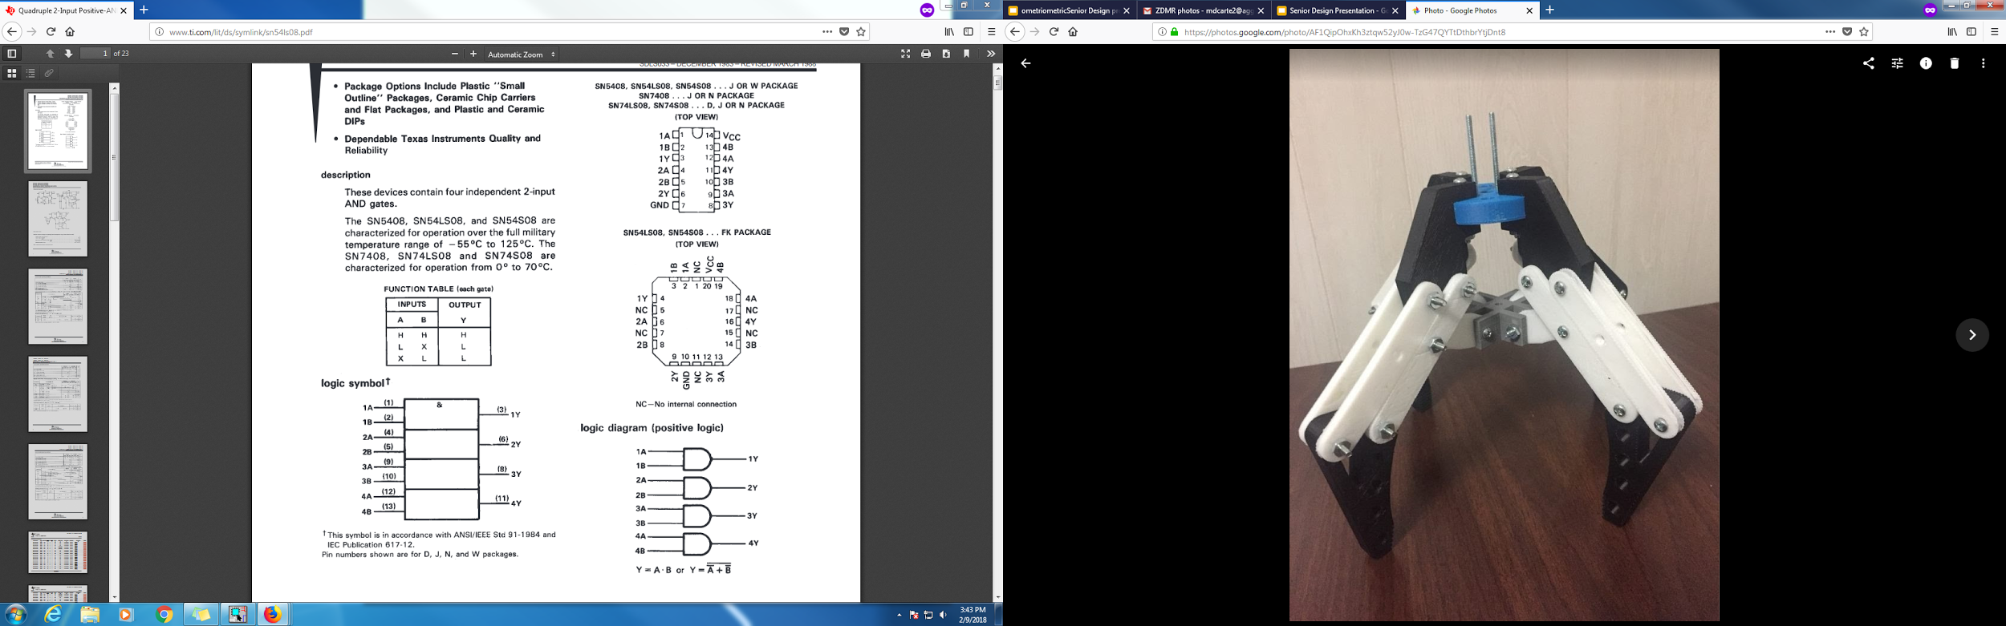
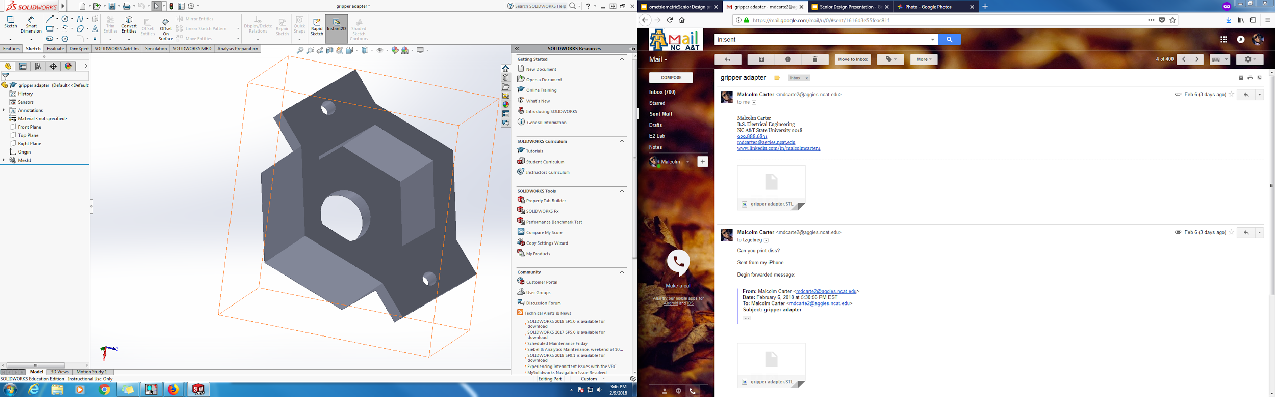
Gripper Design
3D print design SUCCESS
Servo Modification
FAIL
Notes:
Yi Si

Slide 7
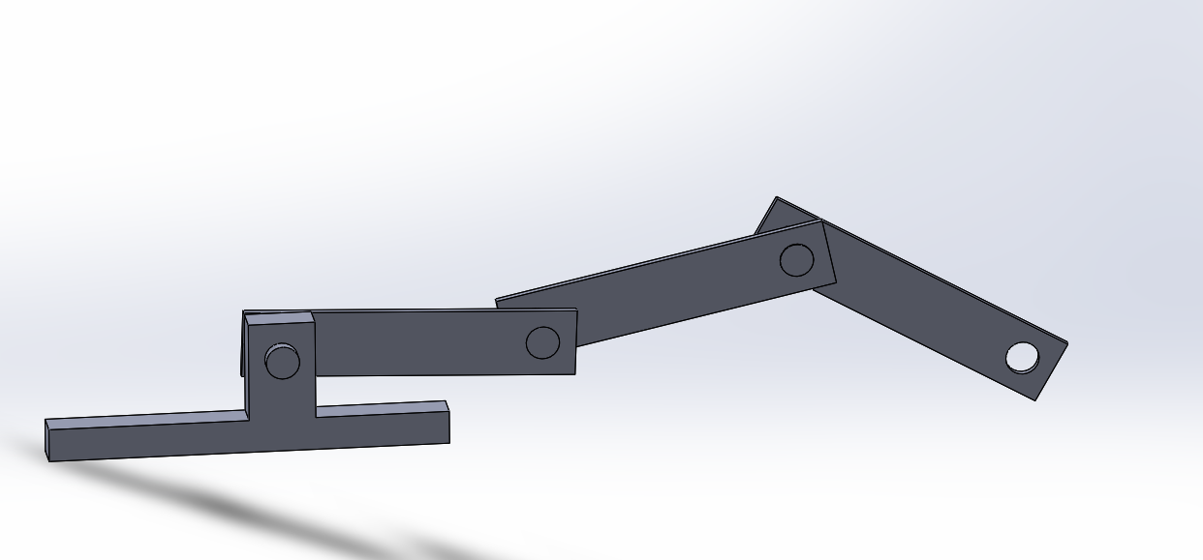
Motion Planning
Simulation
SOLIDWORKS Assembly
Simulink 3D Virtual Reality Toolbox
Notes:
TG
Relationships between the positions, velocities and accelerations
Collision avoidance
Singularity avoidance
Forward transformation equation: location of the hand based on angles and displacements between the links
Inverse Kinematics
Inverse transformation equations, relationship between links and hand in space
Algebraic Approach-A LOT of Matrix equations
Geometric Approach-Geometry+trigonometric formulas WE WILL CHOOSE THIS ONE
Numeric Approach-Move, measure, repeat

Slide 8
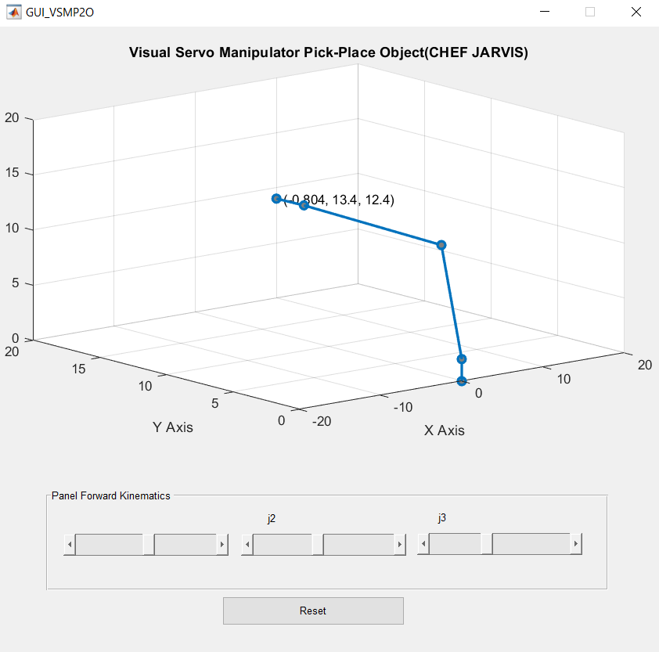
Kinematics
Forward
Inverse

Slide 9
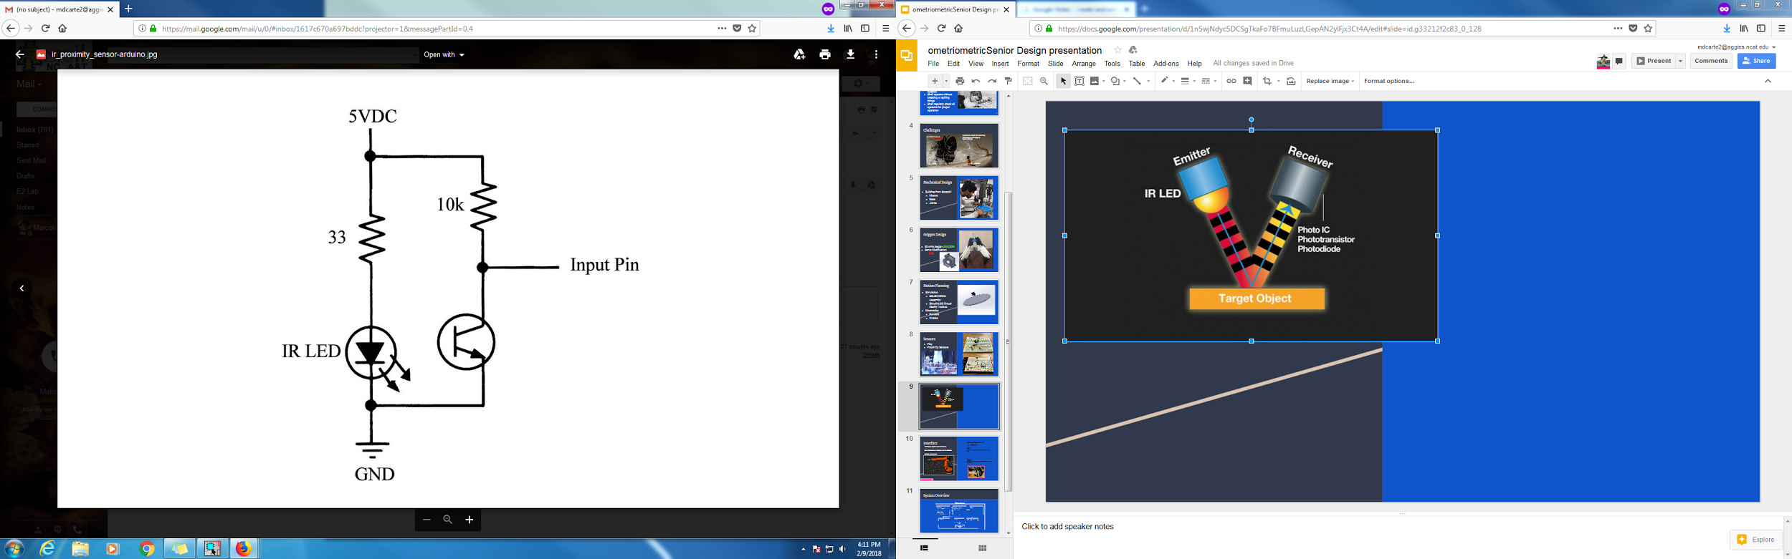
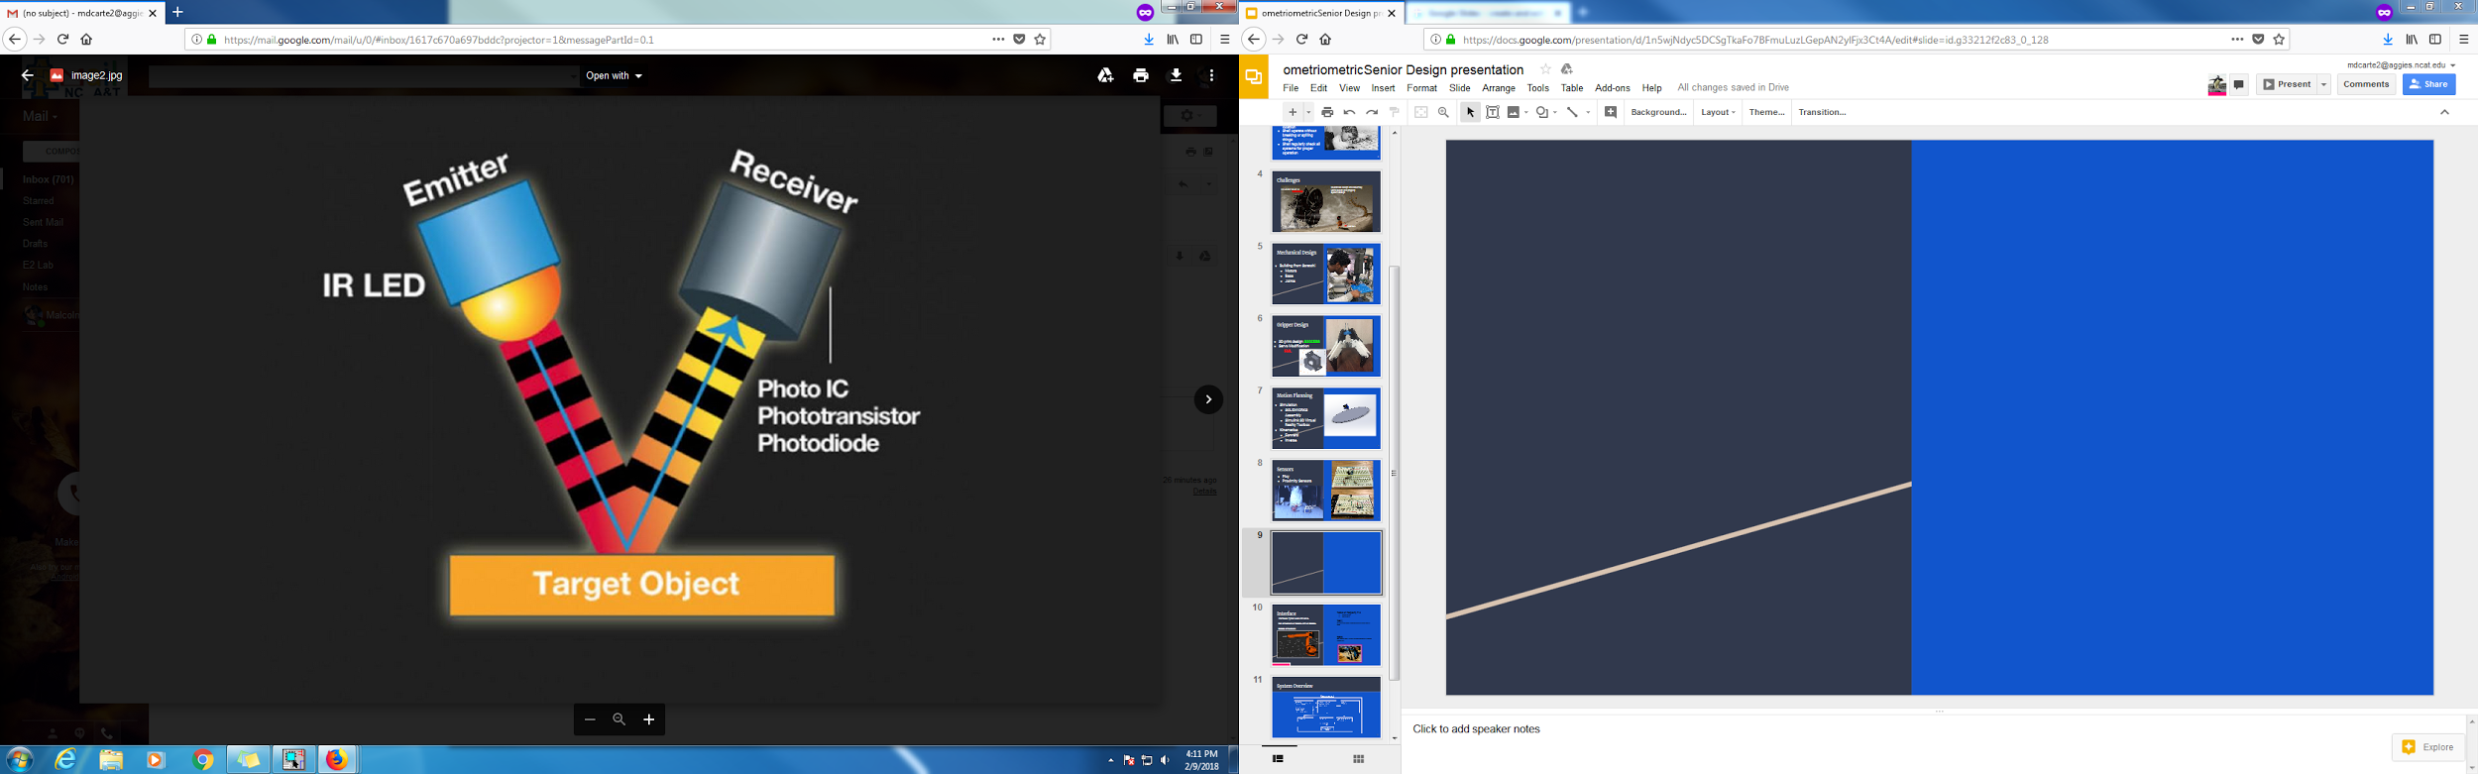
Sensors (cont’d)

Slide 10
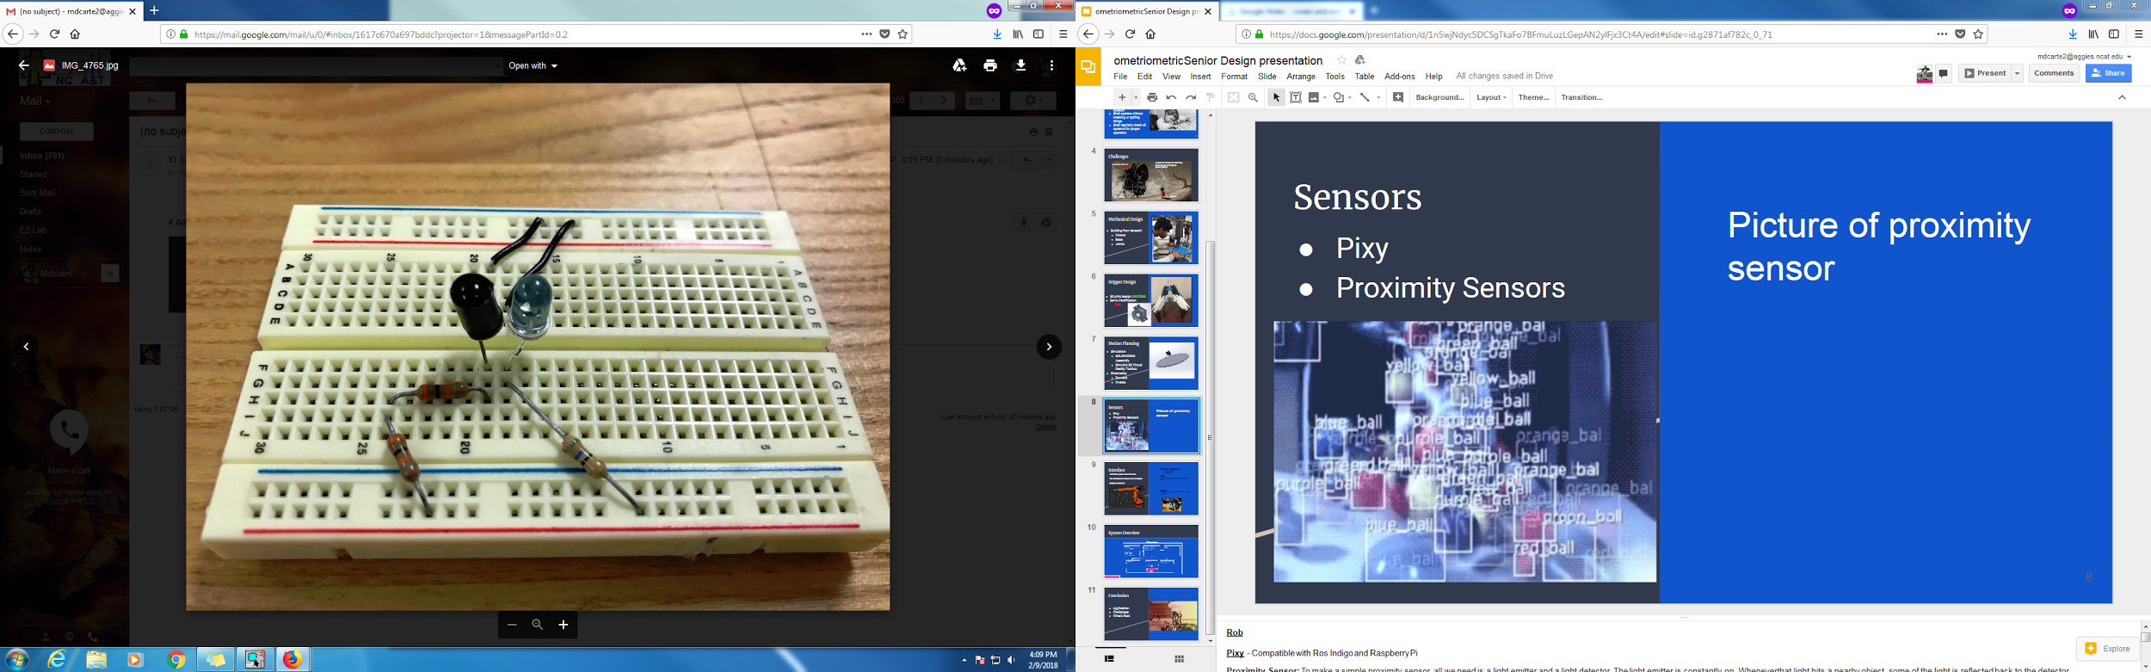
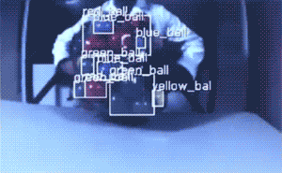
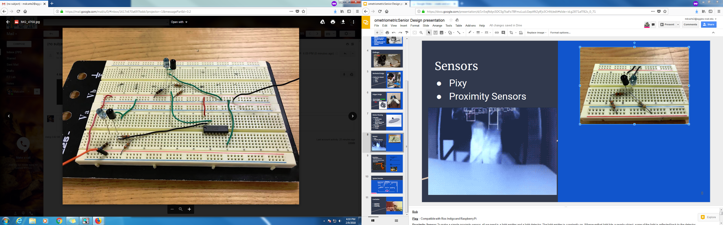
Sensors
Pixy
Proximity Sensors
Notes:
Rob
Pixy - Compatible with Ros Indigo and Raspberry Pi
Proximity Sensor: To make a simple proximity sensor, all we need is a light emitter and a light detector. The light emitter is constantly on. Whenever that light hits a nearby object, some of the light is reflected back to the detector. The closer the object is, the more light will be reflected. By measuring the output of the light detector, We can get a rough approximation of how close the object is.
Gyroscope: Monitors the orientation of the hand maneuvering, to insure that it is parallel to the ground
Raspberry Pi]

Slide 11
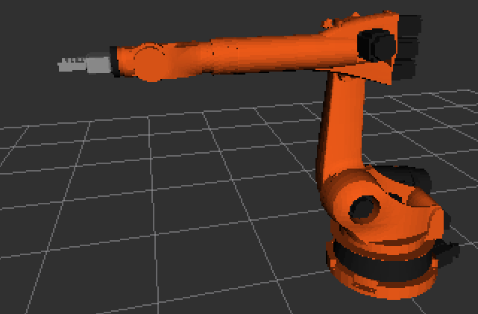
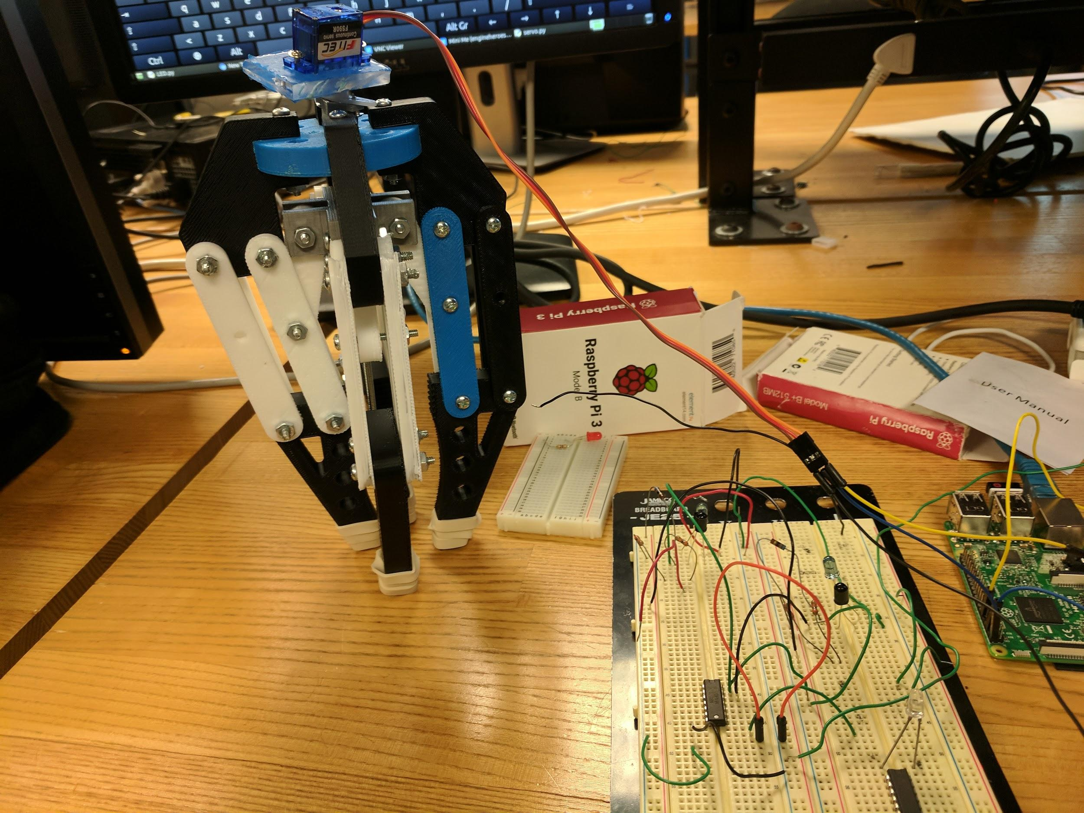
Interface
Tested on Raspberry Pi 3
Ubuntu Mate
Ros Kinetic
Test 1:
Using Python code, powered servo to close robotic hand
Test 2:
Ros Simulations, to familiarize ourselves with inverse kinematics.
Interfaced: Python code with servo:
Ran simulations of Robotic Arm on Gazebo:
Gazebo simulations:

Slide 12

System Overview
12V
Notes:
ROB
Vision Detection: Using a camera, determine the size and distance of objects
Proximity Sensors: Detect obstacles within a certain distance
Accelerometer: Orientation changes to each arm segment
Gyroscope: Monitors the orientation of the hand maneuvering, to insure that it is parallel to the ground
Power Supply: DC Source
Switch: Two states Load objects or Unload objects
Servos: Current, Velocity and Position

Slide 13
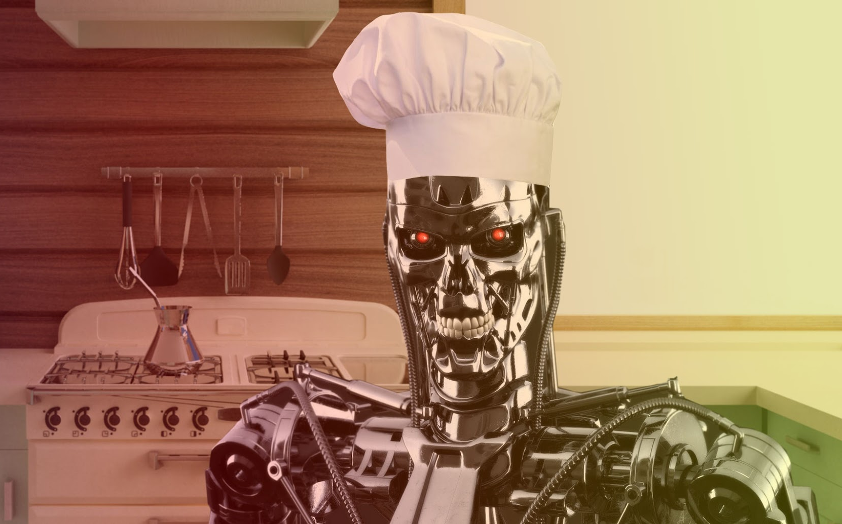
Conclusion
Application
Challenges
What’s Next
Notes:
TG
http://www.instructables.com/id/Raspberry-Pi-and-ROS-Robotic-Operating-System/
Application CJ can be used in residential or commercial environments
Challenges Mechanical design, Gripper design/assembly, Motion planning using kinematics

Slide 14
Literature
J. J. Craig, Intrduction to Robotics: Mechanics and Manipulations, 3rd ed., 2004.
A. Khatamian, "Virtual Manufacturing Automation by
6-DOF Manipulator in USARSim Simulation Area
under Unreal Engine 3 (BSc. Thesis in Persian)," IranUniversity of Science and Technology, Tehran, 2011.
Sevilla M, Robot Arm- Pick & Place Project,(2017), GitHub repository, https://github.com/mithi/arm-ik

